Slide 1



SKKU Biostats and Big data
CHOONG-WAN WOO | COCOAN lab | http://cocoanlab.github.io

Slide 2
GBME Probability and Statistics | Spring 2022
Lecture 01
Lecture 01
Course overview
CHOONG-WAN WOO | COCOAN lab | http://cocoanlab.github.io

Slide 3

Lecture 01
Introduction
Lab webpage
https://cocoanlab.github.io/
CHOONG-WAN WOO | COCOAN lab | http://cocoanlab.github.io

Slide 4
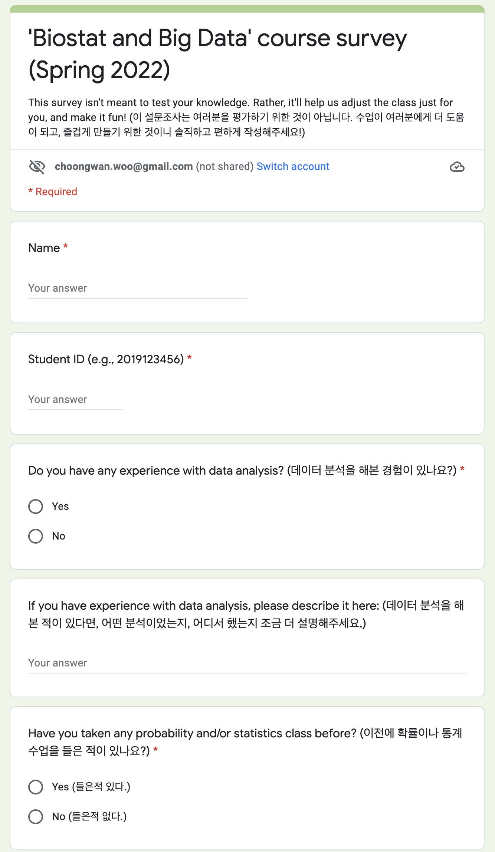
Lecture 01
Survey
Please complete this before our first livestream class (2/28):
https://forms.gle/GgvHDnYGD4JF6nqd6
CHOONG-WAN WOO | COCOAN lab | http://cocoanlab.github.io

Slide 5
Lecture 01
Course overview
Biostats and Big data (previously GBME’s Probability and Statistics)
Class code: GBE 3064
Intro Stats
Textbook: "Stats: Data and Models" by De Veaux, Velleman, and Bock, Fourth Edition
Third edition also works!
CHOONG-WAN WOO | COCOAN lab | http://cocoanlab.github.io

Slide 6
Lecture 01
Course overview
Biostats and Big data (previously GBME’s Probability and Statistics)
Class code: GBE 3064
Intro Stats
Textbook: "Stats: Data and Models" by De Veaux, Velleman, and Bock, Fourth Edition
Third edition also works!
And also I’m writing a textbook in Korean.. Maybe coming soon.. I will share some of them.
Two useful web-based platforms for the class:
Slack for class-related discussion and questions
GitHub for posting class-related materials, assignments, data, codes, etc
CHOONG-WAN WOO | COCOAN lab | http://cocoanlab.github.io

Slide 7
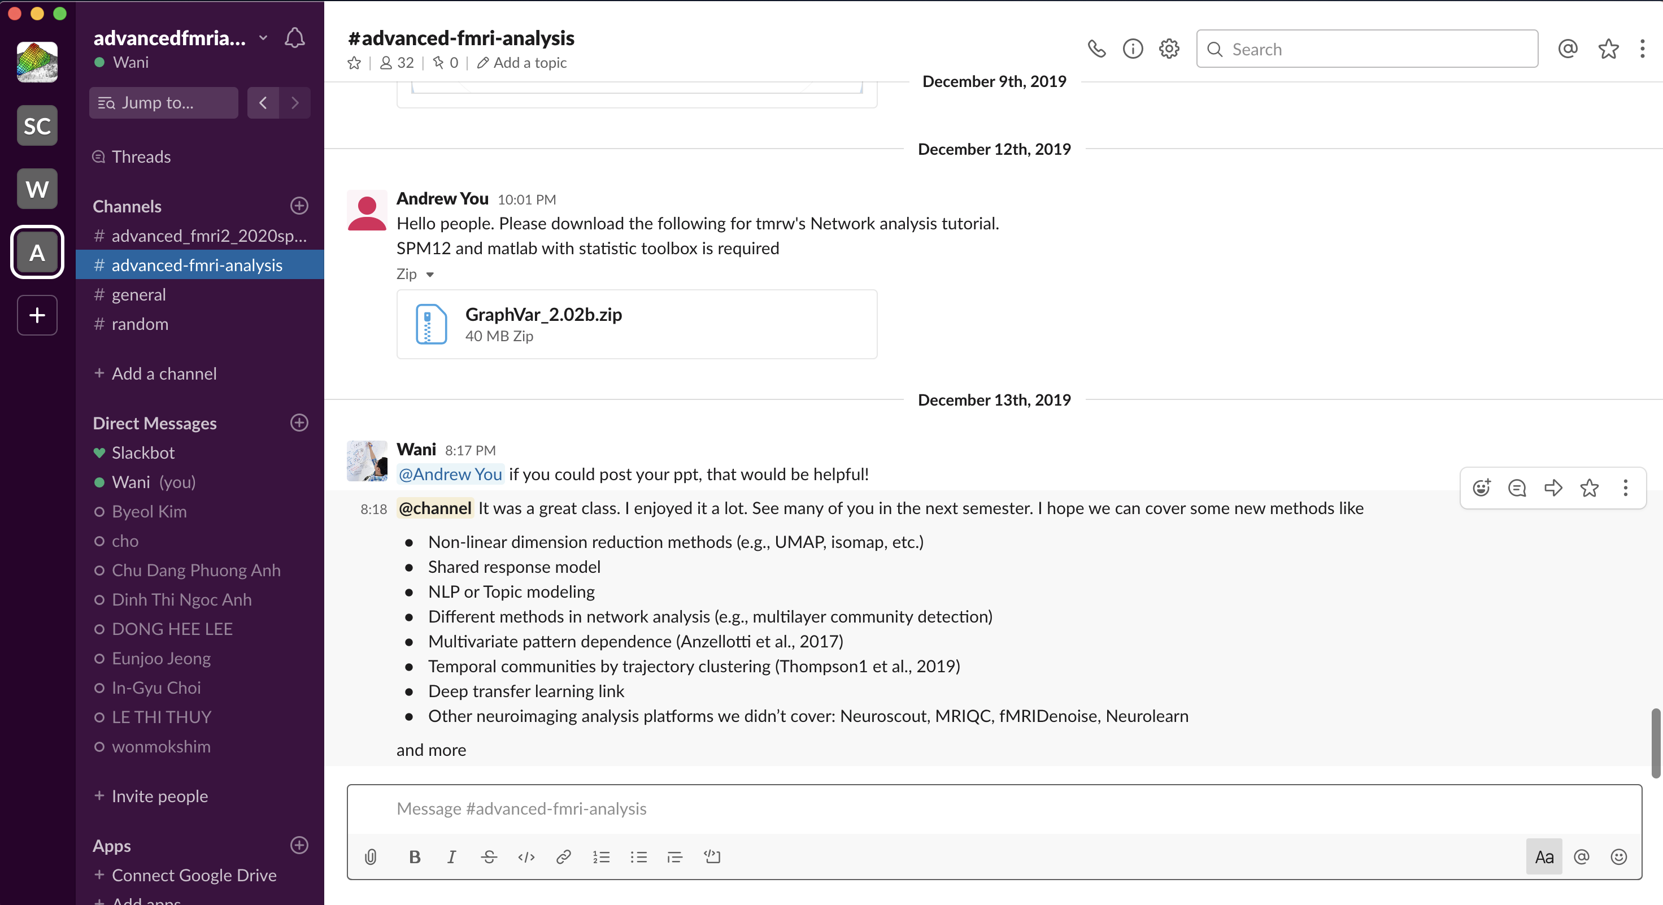
Lecture 01
A great platform for team communications
I will share the link for the class during the first week of the class (you should join)
Works for both desktop and mobile phone
Real examples
CHOONG-WAN WOO | COCOAN lab | http://cocoanlab.github.io

Slide 8
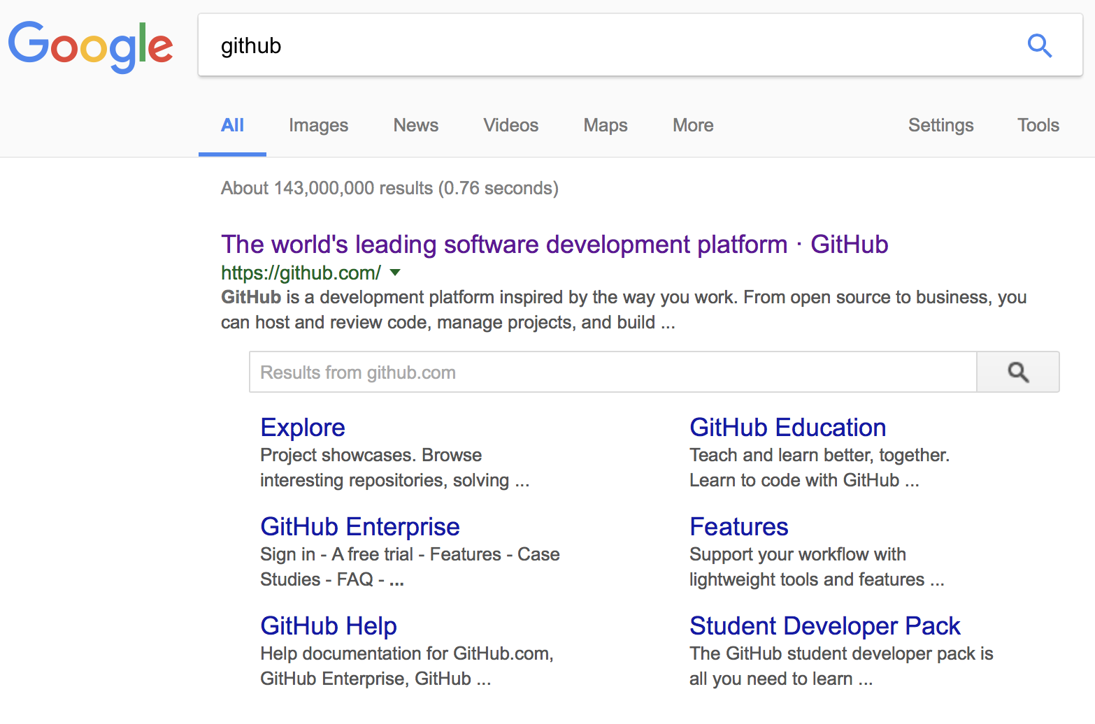
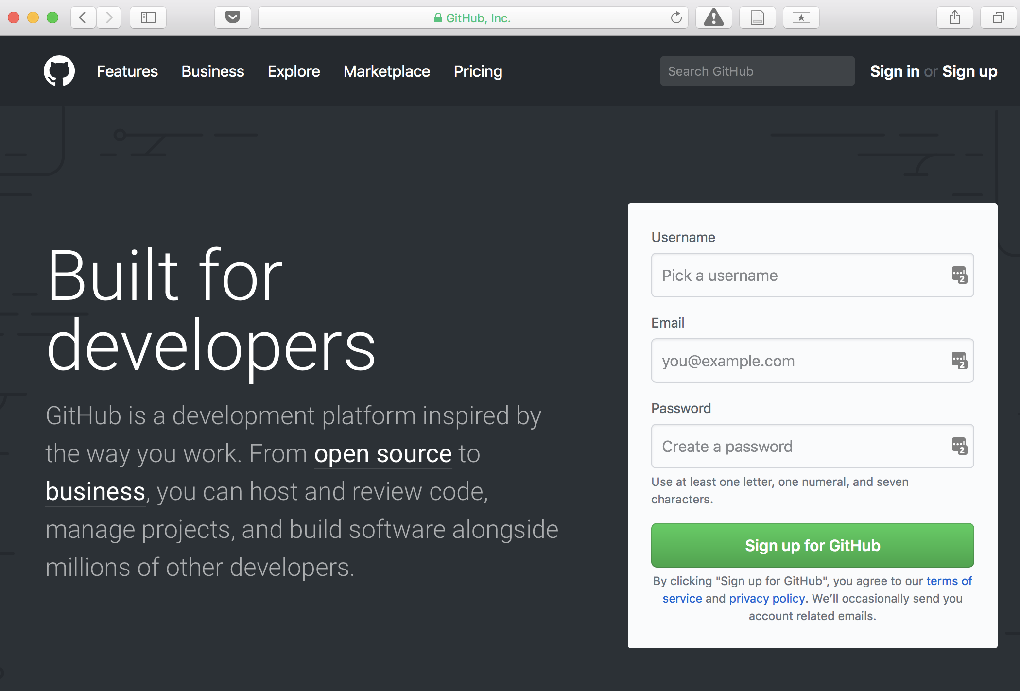
Lecture 01
Most popular software development platform: version control, easy-sharing scripts and data, etc.
CHOONG-WAN WOO | COCOAN lab | http://cocoanlab.github.io

Slide 9
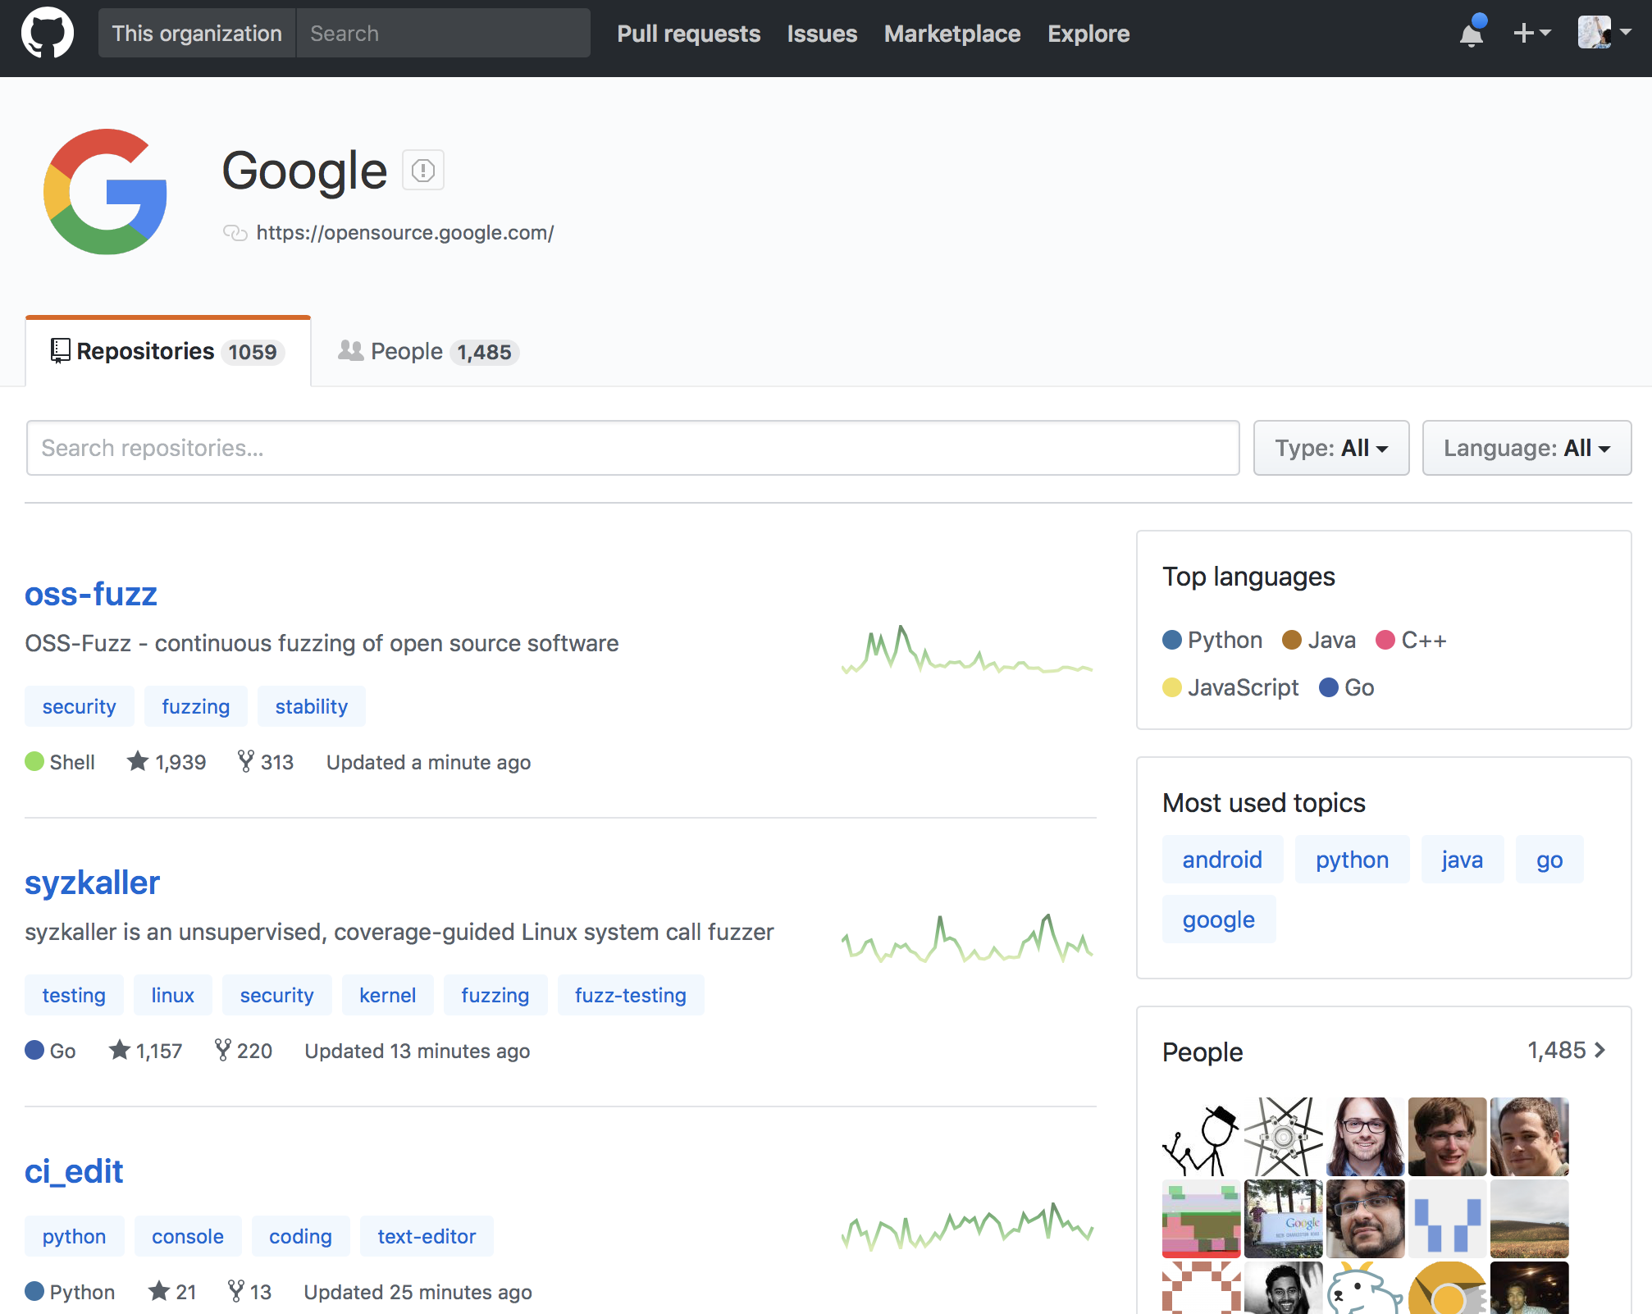
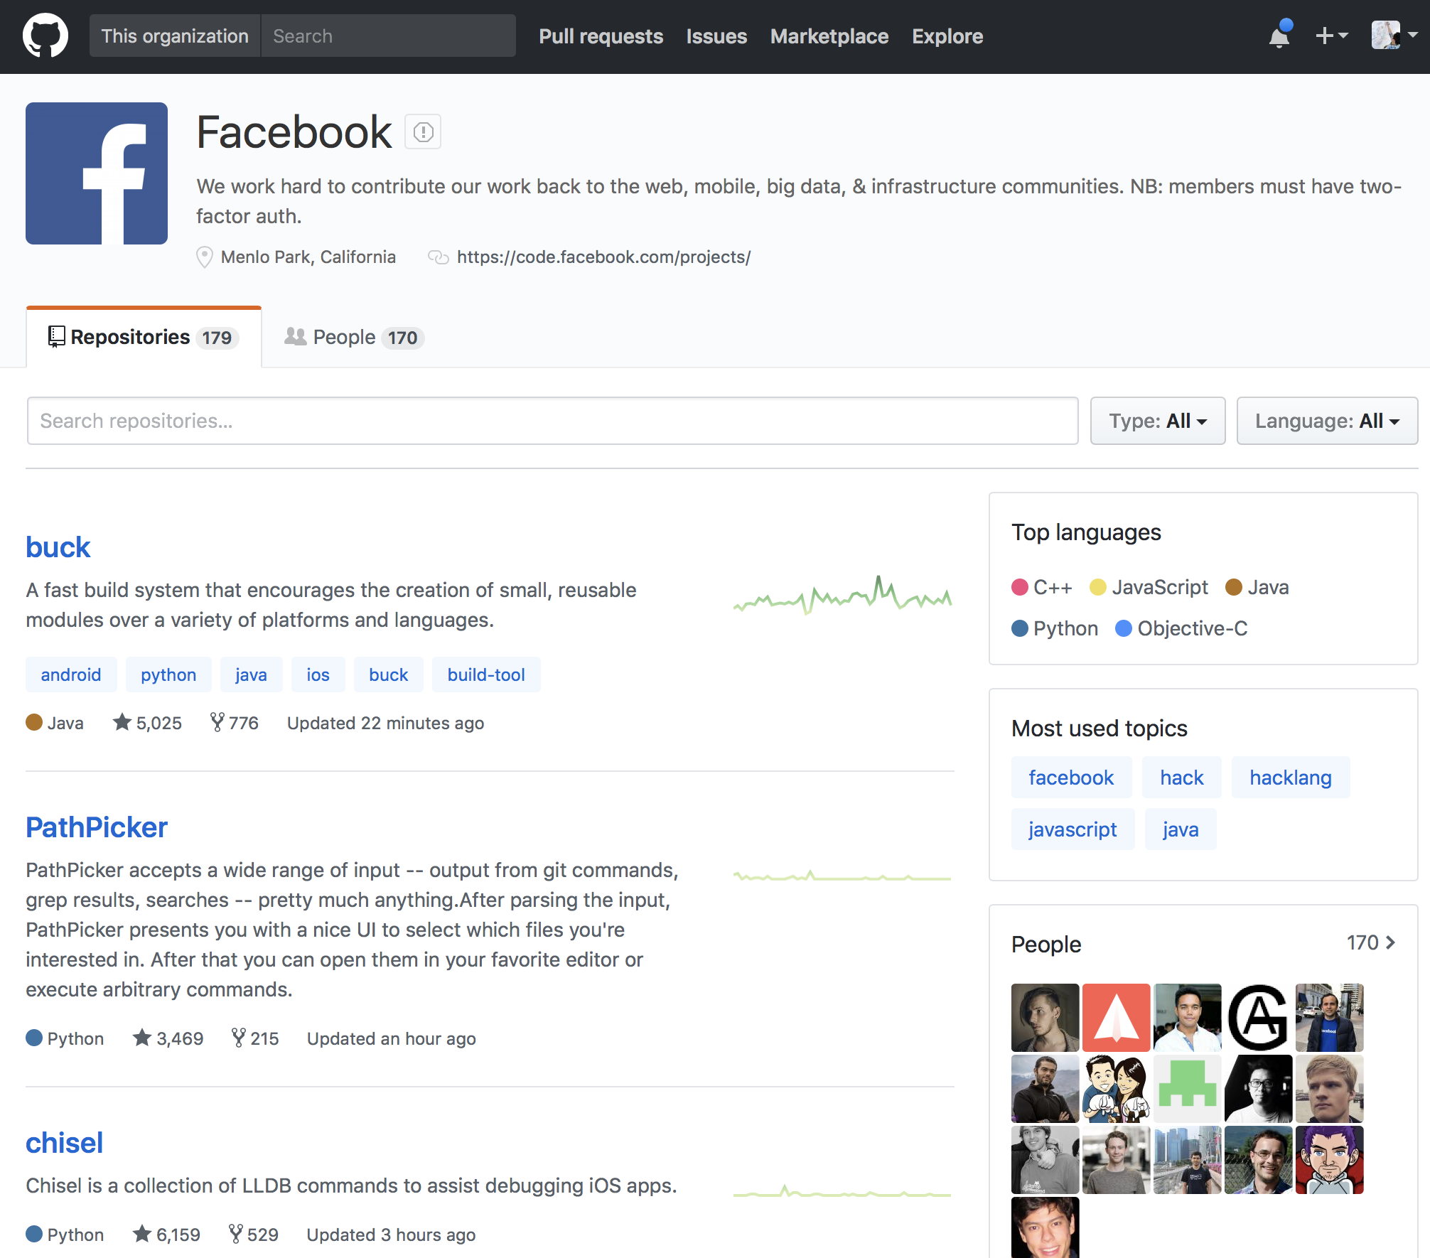
Lecture 01
Most popular software development platform: version control, easy-sharing scripts and data, etc.
Everyone uses GitHub for the development, including Google, Facebook, etc.
CHOONG-WAN WOO | COCOAN lab | http://cocoanlab.github.io

Slide 10
Lecture 01
Most popular software development platform: version control, easy-sharing scripts and data, etc.
Everyone uses GitHub for the development, including Google, Facebook, etc.
More and more people are creating and sharing a GitHub repository for their research and publications:
CHOONG-WAN WOO | COCOAN lab | http://cocoanlab.github.io

Slide 11

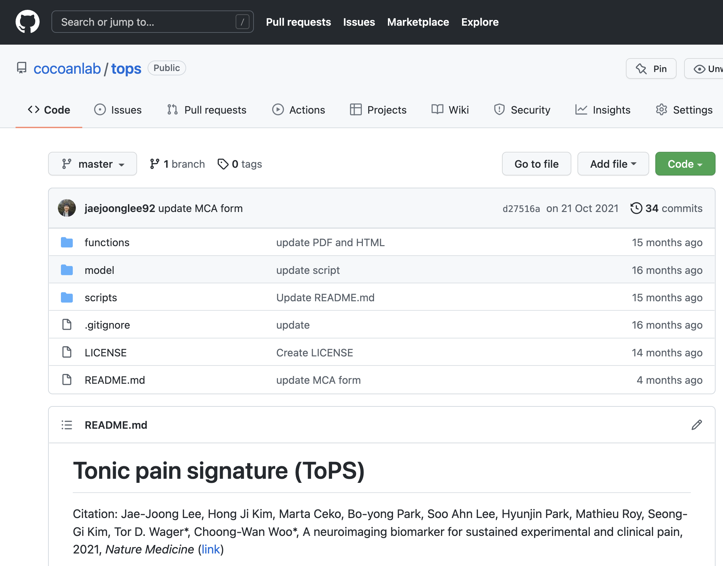
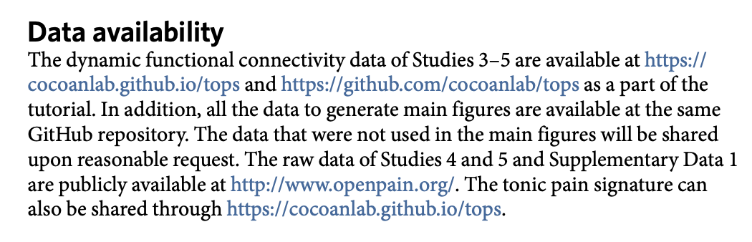
Lecture 01
Most popular software development platform: version control, easy-sharing scripts and data, etc.
Everyone uses GitHub for the development, including Google, Facebook, etc.
More and more people are creating and sharing a GitHub repository for their research and publications:
E.g., Lee et al., 2021, Nature Medicine
CHOONG-WAN WOO | COCOAN lab | http://cocoanlab.github.io

Slide 12
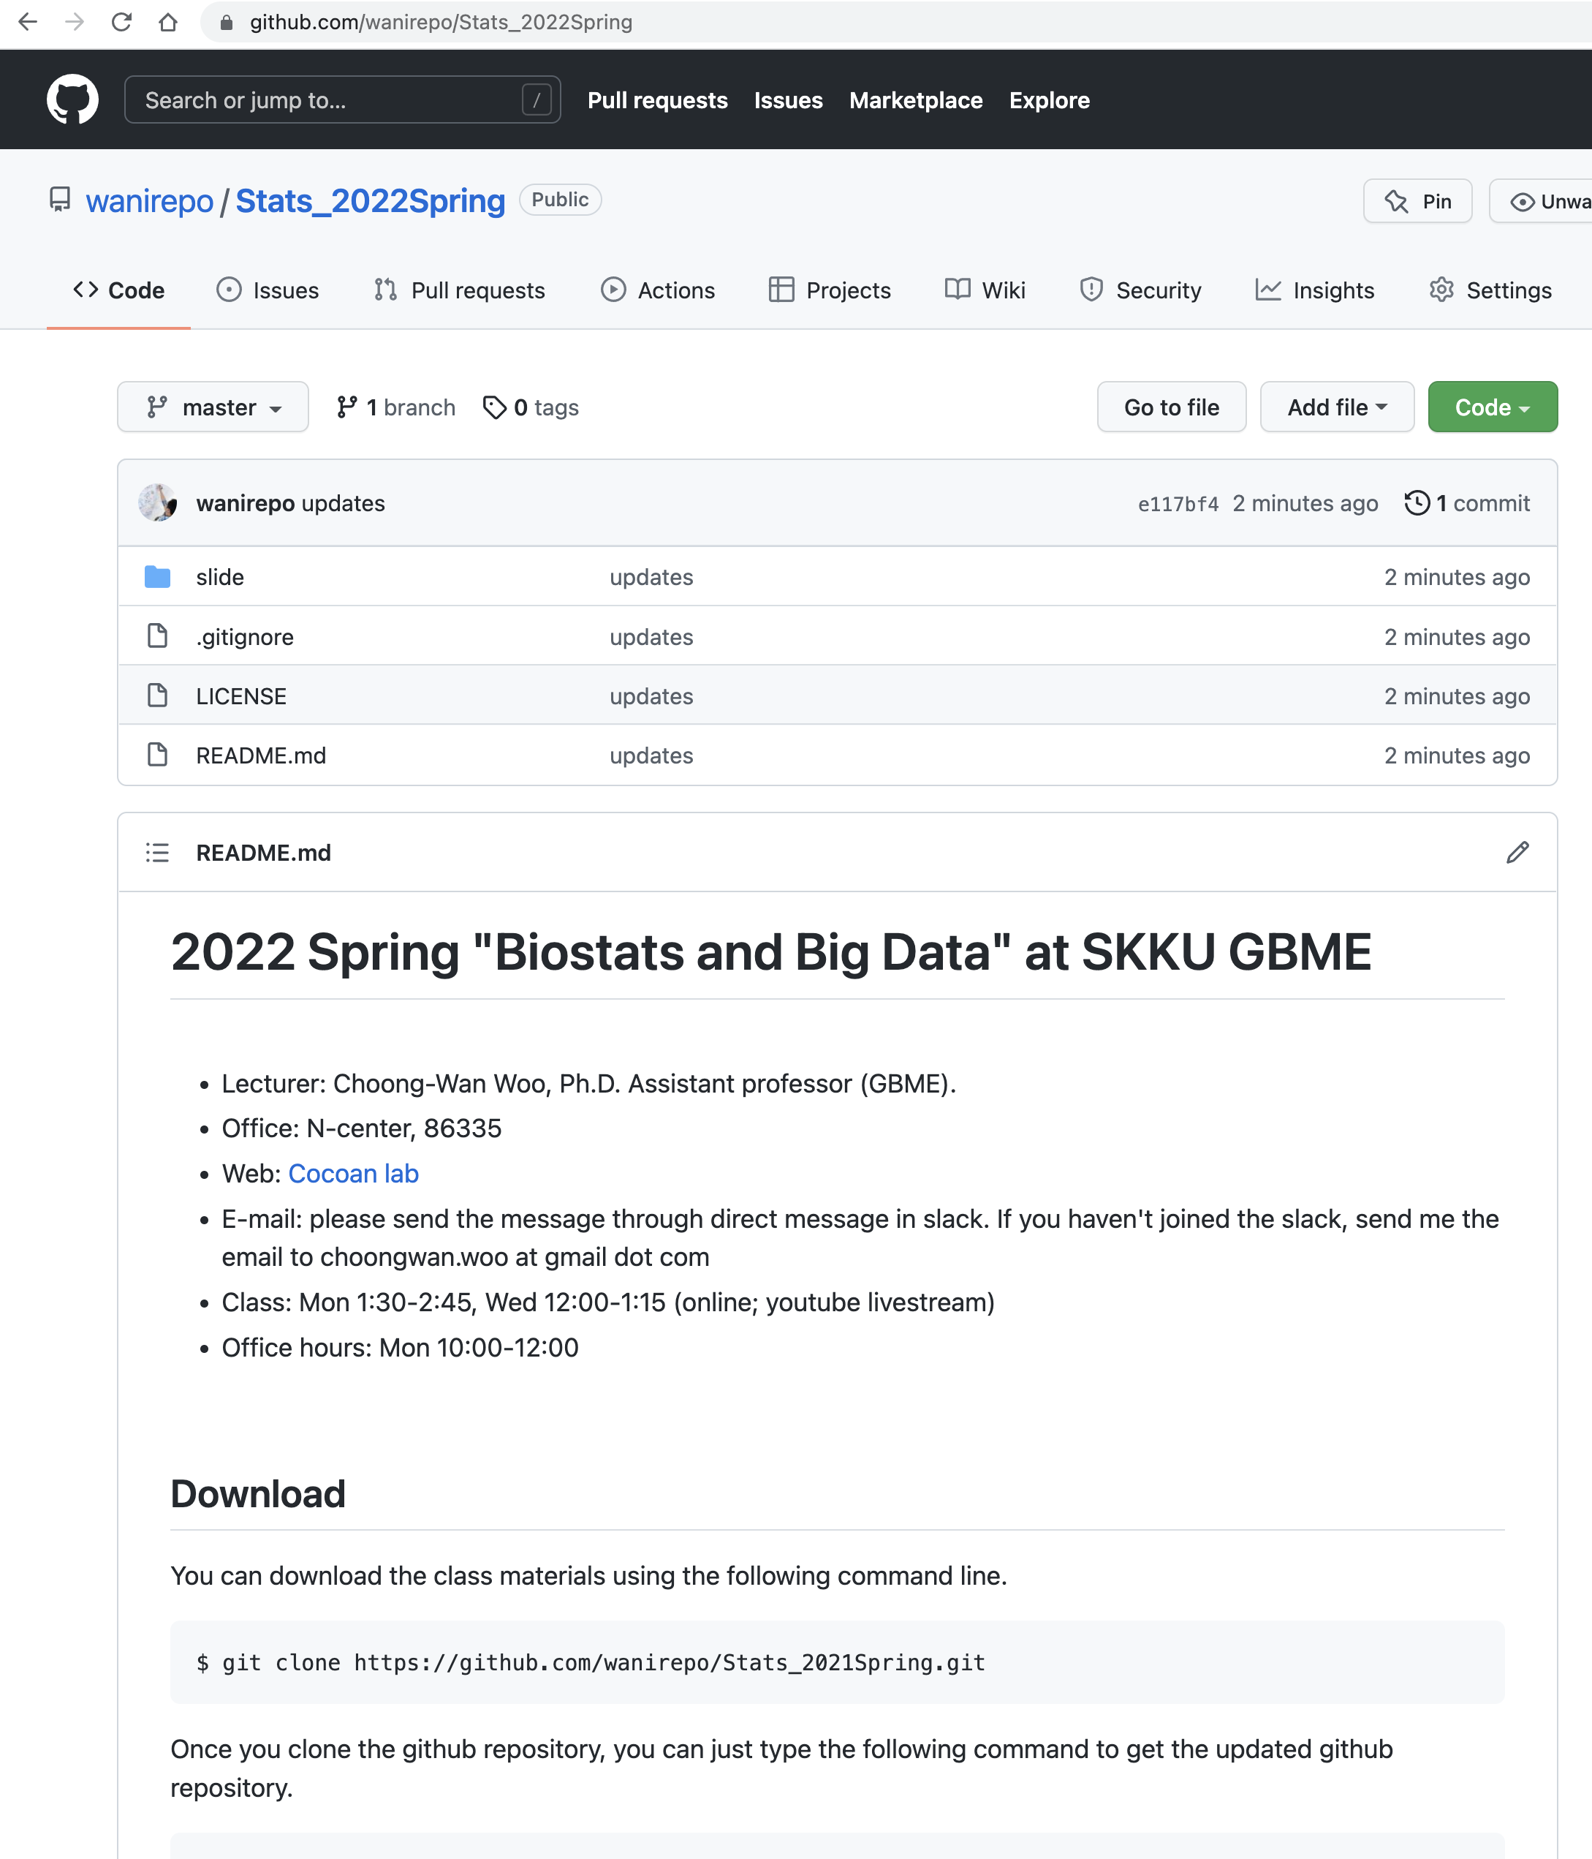
Lecture 01
Our class website: https://github.com/wanirepo/Stats_2022Spring
README.md is the syllabus.
Let’s visit the website and read the syllabus together.
CHOONG-WAN WOO | COCOAN lab | http://cocoanlab.github.io

Slide 13
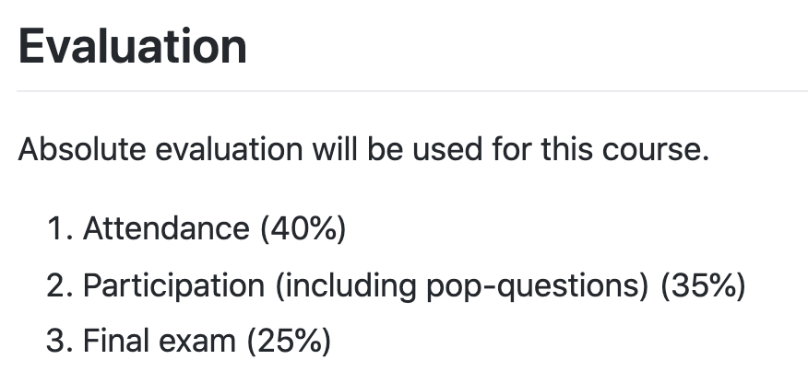
Lecture 01
https://github.com/wanirepo/Stats_2022Spring
For attendance,
I will give you pop-quizes during the livestreaming class using google forms
For each pop-quiz item, you will need to report your student ID and the google forms will record the time you answered
Later, I will count the student ID for each item for a specific period
CHOONG-WAN WOO | COCOAN lab | http://cocoanlab.github.io

Slide 14
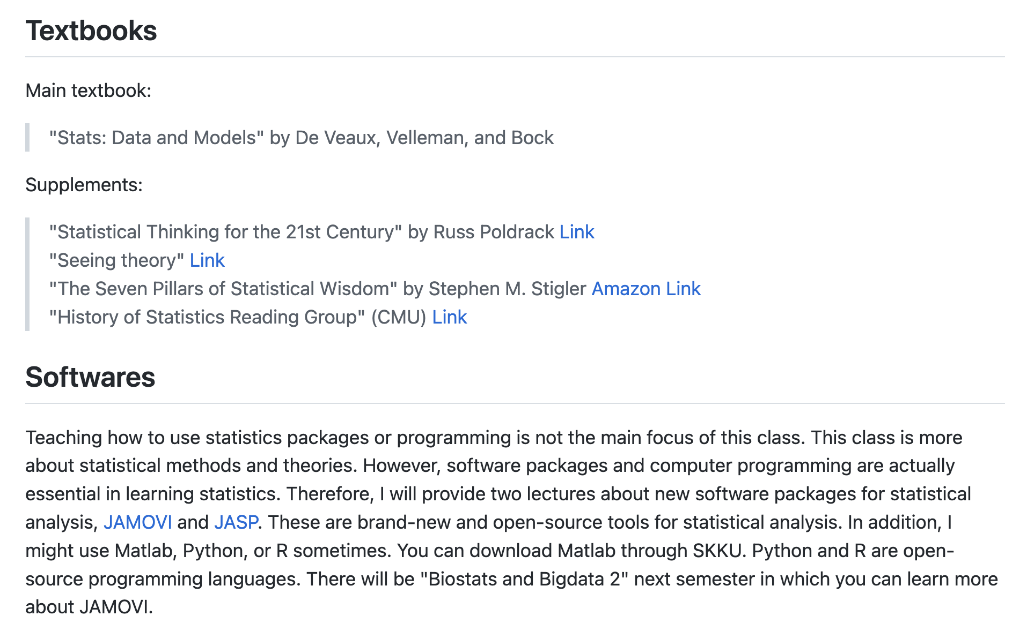
Lecture 01
https://github.com/wanirepo/Stats_2022Spring
CHOONG-WAN WOO | COCOAN lab | http://cocoanlab.github.io

Slide 15
Lecture 01
To-do before the next class
Survey before the next class (2/28): https://forms.gle/GgvHDnYGD4JF6nqd6
Watch the first lecture [V01] Statistics and Data: https://youtu.be/hkMrXhG0ot0
I will send the email or icampus message to ask you to sign up for slack
Next class: 2/28 Monday 1:30 PM (Link: https://youtu.be/6lrKqKfeaBc)
CHOONG-WAN WOO | COCOAN lab | http://cocoanlab.github.io

